Slide 1



2016 IT Challenge
Application Name: PersonaManager
Team Members: Kayode Kolawole Olaleye, Oumar Ba
Coach: Jean-Marc Cadudal

Slide 2

Use-cases and Benefit for users
Business Model
Benefit for Business partners
Future Directions

Slide 3
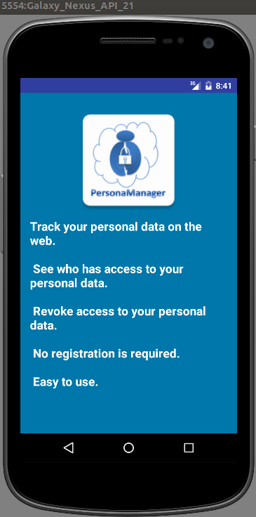
Use-cases and Benefit for users

Slide 4
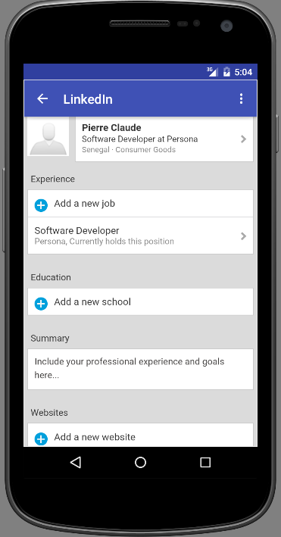
Our prospective users want info stored about them to be factually correct

Slide 5
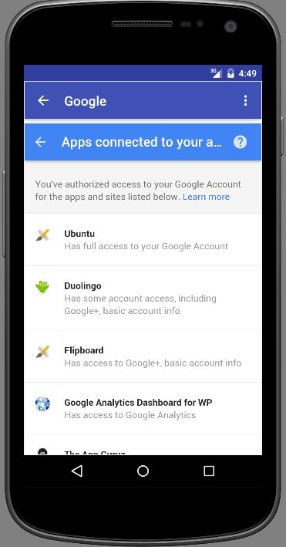
Our prospective users want info stored about them to be available to only those who should have them

Slide 6
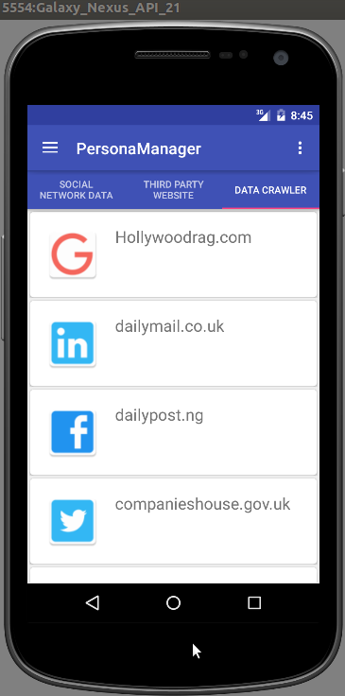
Our prospective users want info stored about them to be used only for intended purpose

Slide 7
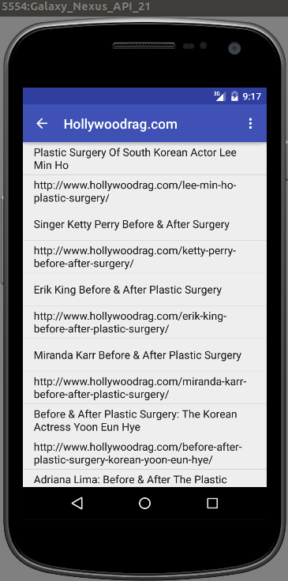
Our prospective users want to know when sensitive info about them is shared online without their authorization

Slide 8
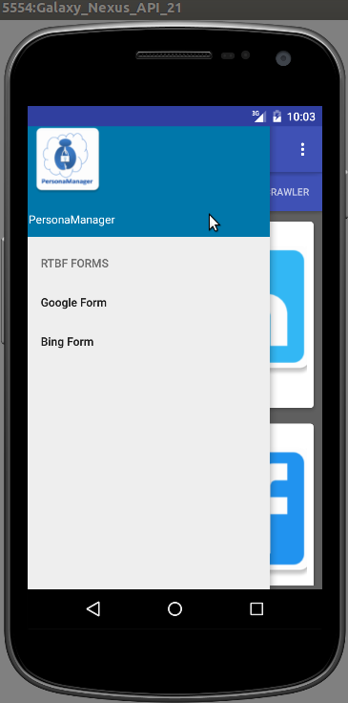
Our prospective users want to be able to request the removal of sensitive info about them

Slide 9
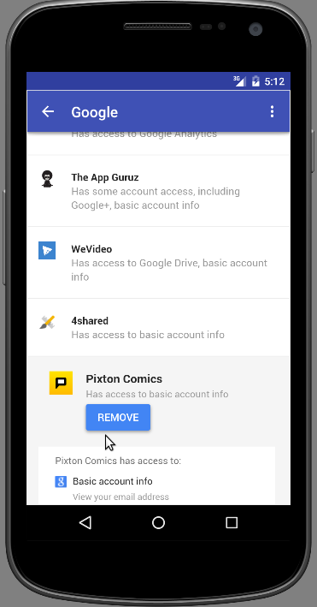
Our prospective users want to be able to opt-out of service they no longer want to have a relationship with

Slide 10
Android Platform
Business Model
Freemium
Customized services

Slide 11
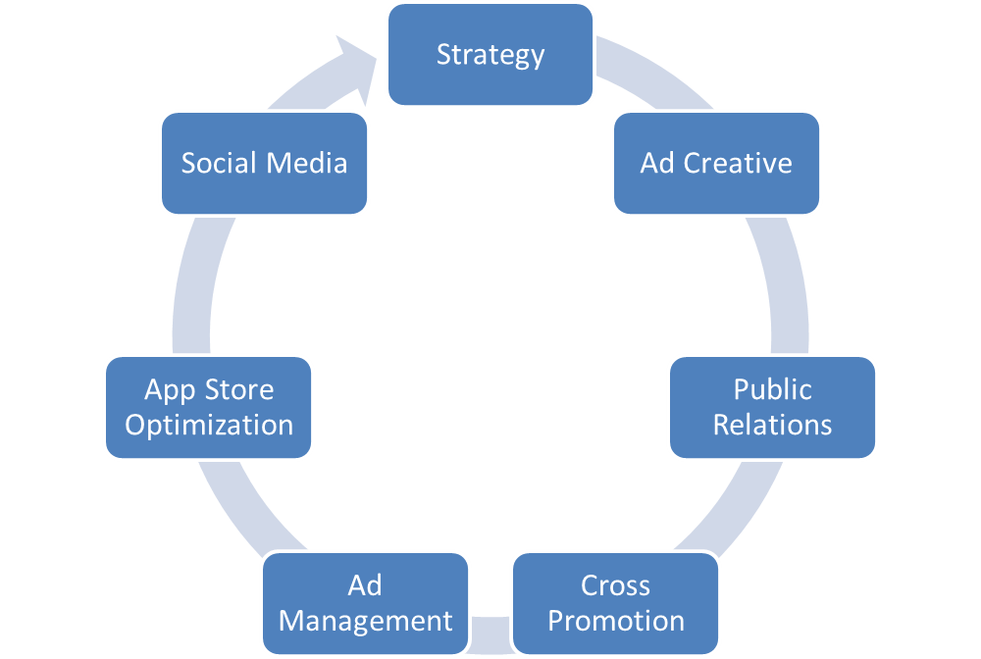

Slide 12
Benefit for Business partners
Feature their brands on app’s landing pages
In-app advertisement

Slide 13
Improve user-interface and performance
Release free version
Future Directions
Add custom features
Unlimited Crawling of web-pages
Background check for unauthorized use of data
Submission and follow-up of removal request
Release premium version

Slide 14
Thank you!

